Slide 1
AC Supply across instrument

Slide 2





AC supply along R
$$V=V_{o}sin\left(ωt\right)$$
$$R$$
$$I=\frac{V}{R}$$
$$I=\frac{V_{o}sin\left(ωt\right)}{R}$$
$$I=I_{o}sin\left(ωt\right)$$

Slide 3






AC supply along R
$$V=V_{o}sin\left(ωt\right)$$
$$R$$
$$I=\frac{V}{R}$$
$$I=\frac{V_{o}sin\left(ωt\right)}{R}$$
$$I=I_{o}sin\left(ωt\right)$$

Slide 4















AC supply along R
AC supply along L
$$V=V_{o}sin\left(ωt\right)$$
$$V=V_{o}sin\left(ωt\right)$$
$$L\frac{di}{dt}=$$
$$I=I_{o}sin\left(ωt\right)$$
$$V_{o}sin\left(ωt\right)$$
$$\frac{V_{o}}{L}$$
$$L$$
$$di=$$
$$sin\left(ωt\right)dt$$
$→$After integration
$$I=\frac{V_{o}}{L}$$
$$×\frac{−cos\left(ωt\right)}{ }$$
$$ω$$
$$ωL=X_{L}$$
Something like resistance
Inductive reactance
$$I=−I_{o}cos\left(ωt\right)$$

Slide 5










AC supply along R
AC supply along L
$$V=V_{o}sin\left(ωt\right)$$
$$V=V_{o}sin\left(ωt\right)$$
$$L\frac{di}{dt}=$$
$$I=I_{o}sin\left(ωt\right)$$
$$V_{o}sin\left(ωt\right)$$
$$\frac{V_{o}}{L}$$
$$L$$
$$di=$$
$$sin\left(ωt\right)dt$$
$→$After integration
$$I=\frac{V_{o}}{L}$$
$$×\frac{−cos\left(ωt\right)}{ }$$
$$ω$$
$$ωL=X_{L}$$
Something like resistance
Inductive reactance
$$I=−I_{o}cos\left(ωt\right)$$

Slide 6
















AC supply along R
AC supply along C
$$V=V_{o}sin\left(ωt\right)$$
$$I=I_{o}sin\left(ωt\right)$$
$$V=V_{o}sin\left(ωt\right)$$
$$Q=$$
$$CV$$
$$=CV_{o}sin\left(ωt\right)$$
AC supply along L
$$\frac{dQ}{dt}=$$
$$CωV_{o}cos\left(ωt\right)$$
$$ωL=X_{L}$$
$$C$$
$$\frac{V_{o}}{1/ωC}cos\left(ωt\right)$$
$$I=−I_{o}cos\left(ωt\right)$$
$$I=$$
$$V=V_{o}sin\left(ωt\right)$$
$$\frac{1}{ωC}=X_{C}$$
Something like resistance
Capacitive reactance
$$I=I_{o}cos\left(ωt\right)$$

Slide 7



AC supply along R
AC supply along C
$$V=V_{o}sin\left(ωt\right)$$
$$I=I_{o}sin\left(ωt\right)$$
$$V=V_{o}sin\left(ωt\right)$$
$$Q=$$
$$CV$$
$$=CV_{o}sin\left(ωt\right)$$
AC supply along L
$$\frac{dQ}{dt}=$$
$$CωV_{o}cos\left(ωt\right)$$
$$ωL=X_{L}$$
$$C$$
$$\frac{V_{o}}{1/ωC}cos\left(ωt\right)$$
$$I=−I_{o}cos\left(ωt\right)$$
$$I=$$
$$V=V_{o}sin\left(ωt\right)$$
$$\frac{1}{ωC}=X_{C}$$
Something like resistance
Capacitive reactance
$$I=I_{o}cos\left(ωt\right)$$

Slide 8













AC supply along R
Phase discussion
$$V=V_{o}sin\left(ωt\right)$$
Resistor
Inductor
Capacitor
$$I=I_{o}sin\left(ωt\right)$$
AC supply along L
$$I_{o}$$
$$V_{o}$$
$$V_{o}$$
$$V_{o}$$
$$ωL=X_{L}$$
$$I_{o}$$
$$I=−I_{o}cos\left(ωt\right)$$
$$V=V_{o}sin\left(ωt\right)$$
AC supply along C
$$I_{o}$$
$$Voltage$$
$$is leading by 90$$
$$Current$$
$$is leading by 90$$
$$both are$$
$$in same phase$$
$$V=V_{o}sin\left(ωt\right)$$
$$I=I_{o}cos\left(ωt\right)$$

Slide 9












Power discussion
Let say $V=V_{o}\sin\left(ωt\right),I=I_{o}sin⁡(ωt+φ)$
$$P_{in}=$$
$$VI=$$
$$V_{o}\sin\left(ωt\right)$$
$$I_{o}sin⁡(ωt+φ)$$
$$=V_{o}I_{o}\sin\left(ωt\right)$$
$$[\sin\left(ωt\right)\cos\left(φ\right)+\sin\left(φ\right)cos⁡(ωt)]$$
$$=V_{o}I_{o}$$
$$[\sin^{2}\left(ωt\right)\cos\left(φ\right)+\sin\left(φ\right)sin⁡(ωt)cos⁡(ωt)]$$
$$P_{averge}=$$
Averge value $\frac{1}{2}$
Averge value $0$
$$\frac{V_{o}I_{o}}{2}\cos\left(φ\right)$$
$$P_{averge}=$$

Slide 10



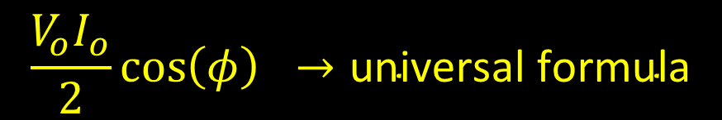



Note
$$\frac{V_{o}I_{o}}{2}\cos\left(φ\right) →\text{universal} \text{formula}$$
$P_{averge}=$
power factor
Cos$θ$ is called
$$\frac{V_{o}I_{o}}{2}$$
Apparent power loss
Power loss happen only across
resistor
We can use DC formula[$P=VI$,$P=I^{2}R$,$P=V^{2}/R$] for power if we use RMS value
$ω_{power}$
$$=2ω$$

Slide 11






Wattless current
$$I$$
$$Isinθ$$
Wattless current is
$$Isinθ$$
$$θ$$
$$V$$
$$Icosθ$$

Slide 12
LC circuit

Slide 13



LC circuit
Neither capacitor nor inductor can lose energy
$$Energy$$
$$L$$
$$C$$

Slide 14
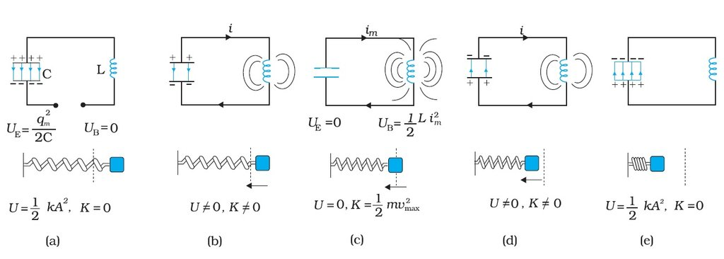



$$\frac{1}{2}CV^{2}$$
=
$$\frac{1}{2}LI^{2}$$
=
$$\frac{1}{2}Li^{2}+\frac{1}{2}Cv^{2}$$
Convert DC to AC
Used to _________________
Store energy
Tank circuit as it ___________

Slide 15




$$\frac{1}{2}CV^{2}$$
=
$$\frac{1}{2}LI^{2}$$
=
$$\frac{1}{2}Li^{2}+\frac{1}{2}Cv^{2}$$
Question
Suppose a capacitor is changed to voltage V then connected to inductor L find maximum current that pass from it
Question
Find current in Inductor when it have 3 times the energy of capacitor.

Slide 16
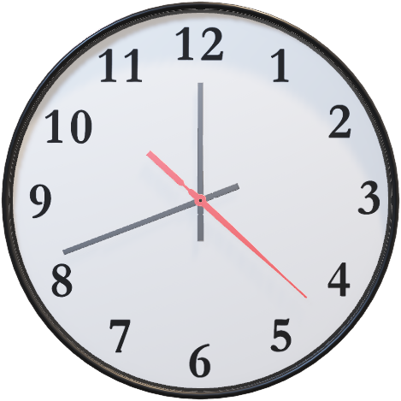


$$Energy$$
$$C$$
$$L$$

Slide 17




















$$x$$
$$q$$
electrical inertia
L is called ______________
$$v$$
$$i$$
$$\frac{1}{2}\frac{q^{2}}{C}$$
$$ω=\frac{2π}{T}$$
$$\frac{1}{2}kx^{2}$$
$$T⇒$$
$$\frac{1}{2}mv^{2}$$
$$\frac{1}{2}Li^{2}$$
$$T=\frac{2π}{ω}$$
$$=2π\sqrt{LC}$$
$$\frac{1}{2π\sqrt{LC}}$$
$$\frac{1}{C}$$
$$f=$$
$$k$$
NOTE:
Can do 100 question from topic SHM on a line
$$m$$
$$L$$
$$ω_{o}=\sqrt{\frac{1}{LC}}$$
$$ω_{o}=\sqrt{\frac{k}{m}}$$

Slide 18
LC oscillator practical situation (with R)

Slide 19


LC oscillator practical situation (with R)
$$L$$
$$C$$
Amplitude decrease exponential
Frequency remain constant

Slide 20
RLC with supply

Slide 21



















RLC with supply
$$V_{l}$$
$$V_{supply}$$
$$I$$
$$V_{l}−V_{c}$$
$$φ$$
$$I_{r}$$
$$I_{r}$$
$$I_{l}$$
$$I_{c}$$
$$V_{c}$$
$$V_{r}$$
$$V_{r}$$
$$V_{l}$$
$$V_{c}$$
$$V_{supply}$$
$$=\sqrt{{\left(V_{l}−V_{c}\right)}^{2}+{\left(V_{r}\right)}^{2}}$$
$${\left(V_{l}−V_{c}\right)}^{2}$$
$$+{\left(V_{r}\right)}^{2}$$
$$V_{o}\sin{(ωt+φ)}$$

Slide 22




















$$V_{supply}$$
$$V_{supply}$$
$$=\sqrt{{\left(V_{l}−V_{c}\right)}^{2}+{\left(V_{r}\right)}^{2}}$$
$${\left(V_{l}−V_{c}\right)}^{2}$$
$$+{\left(V_{r}\right)}^{2}$$
$$V_{l}−V_{c}$$
$$IZ=$$
$$\sqrt{ {\left({ V}_{l}−V_{c}\right)}^{2}+{\left(V_{r}\right)}^{2}}$$
$$φ$$
$$(IX_{l}−$$
$$IX_{c}) ^{2} +$$
$${\left(IR\right)}^{2}$$
$$V_{r}$$
$$=\sqrt{ {\left(V_{l}−V_{c}\right)}^{2}+{\left(V_{r}\right)}^{2}}$$
$$Z$$
$${\left(X_{l}−X_{c}\right)}^{2}$$
$$+ {\left(R\right)}^{2}$$
$$Z$$
$Z$ is called impedance
$$X_{l}−X_{c}$$
$$φ$$
$$R$$
Impedance triangle

Slide 23











$$V_{supply}$$
Students can write voltage equation
$$V_{l}−V_{c}$$
Students can write Impedance equation
$$φ$$
Students can write tan$φ$ and $cosφ$
$$V_{r}$$
Students can write Current in R,L,C,NET form
$$=\frac{V_{r}}{R}$$
$$=\frac{V_{l}}{X_{l}}$$
$$=\frac{V_{c}}{X_{c}}$$
$$=\frac{V_{s}}{Z}$$
$$Z$$
$$I$$
$$X_{l}−X_{c}$$
$$φ$$
$$=\frac{V_{s}}{\sqrt{{\left(X_{l}−X_{c}\right)}^{2}+R^{2}}}$$
$$R$$
Impedance triangle

Slide 24

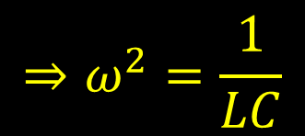



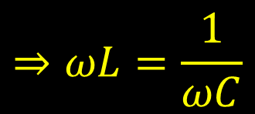













$$=\frac{V_{s}}{\sqrt{{\left(X_{l}−X_{c}\right)}^{2}+R^{2}}}$$
$$I$$
$$I$$
$$X_{l}=ωL$$
$$X_{c}=\frac{1}{ωC}$$
$$ω$$
$→$Current is
maximum
$$=\frac{V_{s}}{\sqrt{{\left(ωL−\frac{1}{ωC}\right)}^{2}+R^{2}}}$$
$$I$$
$→$Impendece is
minimum
$$⇒ωL=\frac{1}{ωC}$$
$$⇒ω^{2}=\frac{1}{LC}$$
$$=\frac{1}{\sqrt{LC}}$$
$→$At $ω=0$
$$I=0$$
$$⇒ω$$
$$=ω_{o}$$
$→$At $ω=∞$
$$I=0$$
This is called resonance

Slide 25
















$$I$$
Resonance
$$⇒ω$$
$$>ω_{o}$$
$$⇒ω$$
$$<ω_{o}$$
$$ω$$
$$X_{l}>X_{c}$$
$$X_{l}<X_{c}$$
$$⇒ω$$
$$=ω_{o}$$
$$X_{l}=$$
$$X_{c}$$
$$Z=$$
$$R$$
Circuit is capacitive
$$I=$$
Circuit is Inductive
$$V_{s}/R$$
Circuit is pure resistive
I Is leading
V is leading
I and V will be in same phase

Slide 26
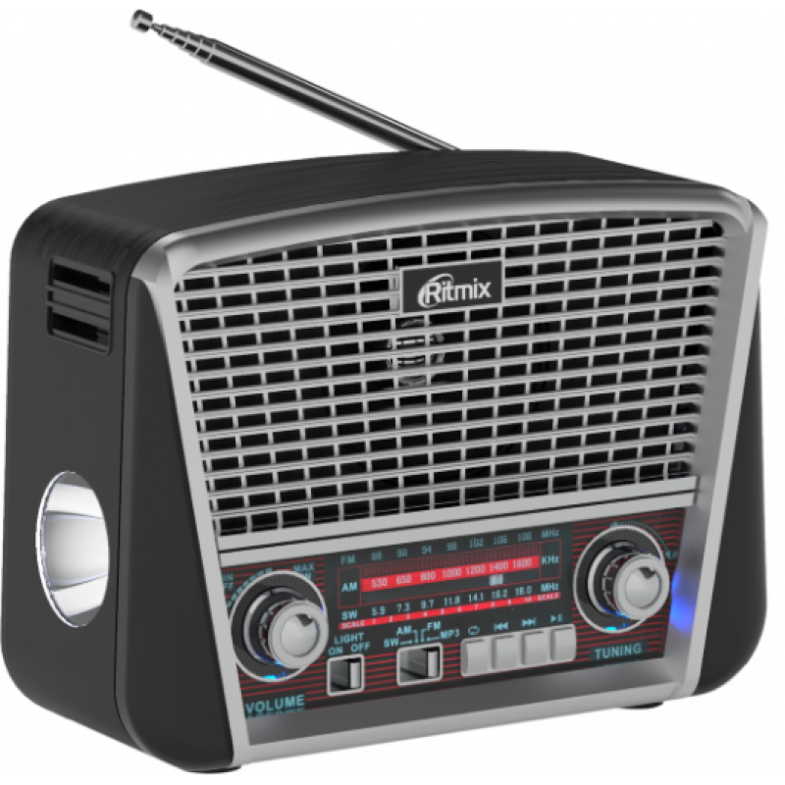
Qualitative idea for
Sharpness and quality
This is better

Slide 27















Sharpness and quality
min(R)
max
max
Z is ______
I is ______
Power is ______
$$I$$
$$−3dB$$
Half power level
$$P_{max}/2⁡$$
Power is ________
$$I_{max}/\sqrt{2}⁡$$
$$Δω$$
Current is ________
$$R×\sqrt{2}⁡$$
$$Z=R\sqrt{2}$$
Impedance is ________
$$ω_{o}$$
$$\sqrt{X^{2}+R^{2}}=R\sqrt{2}$$
$$ω_{1}$$
$$ω_{2}$$
$$ω$$
$$X^{2}+R^{2}=R^{2}×2$$
$$X^{2}=R^{2}$$
$$X=R$$

Slide 28













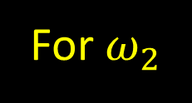









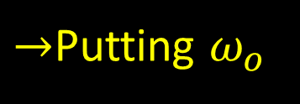


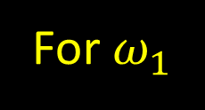









min(R)
max
max
Z is ______
I is ______
Power is ______
$$−3dB$$
$$P_{max}/2⁡$$
Power is ________
$$I_{max}/\sqrt{2}⁡$$
Current is ________
$$R×\sqrt{2}⁡$$
Impedance is ________
$$Z=R\sqrt{2}$$
$$\sqrt{X^{2}+R^{2}}=R\sqrt{2}$$
$$X^{2}+R^{2}=R^{2}×2$$
$$X^{2}=R^{2}$$
Sharpness and quality
$$=\frac{R}{L}$$
$$not \frac{L}{R}$$
Bandwidth
$$Δω$$
$$I$$
Quality factor
Half power level
$$=\frac{ω_{o}}{Δω}$$
$$=\frac{ω_{o}L}{R}$$
$$Δω$$
$$ω$$
$$=\frac{X_{l}}{R}$$
$$=\frac{X_{c}}{R}$$
$$=\frac{V_{l}}{V_{R}}$$
$$=\frac{V_{c}}{V_{R}}$$
$$=\frac{V_{l}}{V_{s}}$$
$$=\frac{V_{c}}{V_{s}}$$
$$ω_{1}$$
$$ω_{o}$$
$$ω_{2}$$
$$X=R$$
$$Q=\frac{1}{R}×\sqrt{\frac{L}{C}}$$
$$=\frac{1}{\sqrt{LC}}$$
$→$Putting $ω_{o}$
For $ω_{2}$
For $ω_{1}$
$$X_{l}−X_{c}=R$$
$$X_{c}−X_{l}=R$$
$$ω_{o}=$$
$$\sqrt{ω_{1}×ω_{2}}$$
$$=approx \frac{ω_{1}+ω_{2}}{2}$$

Slide 29
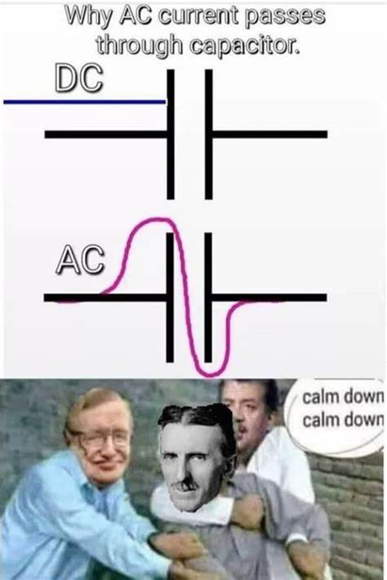


Ways to solve numerical
Look for type of supply first AC or DC
Cell and battery are DC supply
Frequency of DC is zero
$$X_{L}=ωL=0$$
$$X_{C}=\frac{1}{ωC}=∞$$
Capacitor is perfect insulator for DC or say capacitor block DC
All instrument read RMS value and DC instrument will not work with AC supply

Slide 30
If data is simply given it is RMS
Q If V=100sint here 100 is ……….
All these formula we just study are phaser analysis which is done for amplitude(can be used with RMS) not instantaneous value[nearly never asked in exam here use simple addition like KCL and KVL].
If frequency is change remember to change X_{L} and X_{C}
And remember Hz is not unit of ………

Slide 31
In RLC series circuit
Current
is same
Voltage
Treat voltage as vector
V_{L} and V_{C} are in opposite direction
V_{R} is perpendicular to both
Their resultant is supply voltage
Resistance
Treat resistance as vector
X_{L} and X_{C} are in opposite direction
X_{R} is perpendicular to both
Their resultant is Z
Resonance
Maximum
Current is _________
accepter
also known as ________ circuit
If X_{L} > X_{C}
Voltage is leading

Slide 32
In RLC Parallel circuit
Not in course

Slide 33




In RLC Parallel circuit
Voltage
is same
Current
Treat Current as vector
I_{L} and I_{C} are in opposite direction
I_{R} is perpendicular to both
Their resultant is supply current
Resistance
Treat $1/R$ as vector
$1/XL$ and $1/XC$ are in opposite direction
$1/R$ is perpendicular to both
Their resultant is $1/Z$
Resonance
Minimum
Current is _________
rejector
also known as ________ circuit
If X_{L} > X_{C}
Current is leading

Slide 34
NOTE:
If it is not clear that element are in series or parallel assume in series.

Slide 35

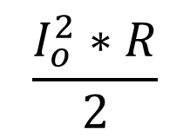












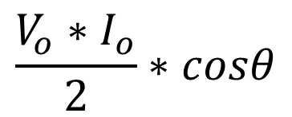

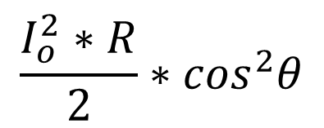



Ase hi dekh lo
$$V_{o}$$
$$V_{RMS}$$
$$I_{o}$$
Power is lost in resistor only and can use formula of DC is use RMS value
$$I_{RMS}$$
$$θ$$
In RLC series
In RLC Parallel
$$\frac{I_{o}^{2}∗R}{2}$$
$$\frac{I_{o}^{2}∗R}{2}∗\cos^{2}θ$$
$$⇒I^{2}R$$
$$I_{RMS}^{2}∗R$$
$$I_{RMS}^{2}∗R∗\cos^{2}θ$$
$$⇒\frac{V^{2}}{R}$$
$$\frac{V_{RMS}^{2}}{R}∗\cos^{2}θ$$
$$\frac{V_{o}^{2}}{2R}∗\cos^{2}θ$$
$$\frac{V_{RMS}^{2}}{R}$$
$$\frac{V_{o}^{2}}{2R}$$
$$\frac{V_{o}∗I_{o}}{2}∗cosθ$$
$$\frac{V_{o}∗I_{o}}{2}∗cosθ$$
$$⇒VI$$
$$V_{RMS}∗I_{RMS}∗cosθ$$
$$V_{RMS}∗I_{RMS}∗cosθ$$

Slide 36
RC

Slide 37
RL

Slide 38
RL-AC VS DC supply

Slide 39

Queston of changing L and C but different material and f vs $ω$

